Slide 1

MatchHub
Live Soccer Match Tracker
By: Jeanne Exantus, Shari Li, Elianny Rodriguez, and Jeremy Jimenez

Slide 2

Why MatchHub?
Our website, MatchHub is an application for users to keep track their soccer matches
User will able to input the soccer team names, the date of the match, and the time of the match
Each match will be categorized as upcoming, ongoing or completed
This site is also for soccer fans as users will be able to view and access soccer stats from the Major League Soccer(MLS)

Slide 3

List of Technologies
HTML (for the framework of the webpages)
CSS (for visual styling)
Javascript (for interactivity & dynamic behaviors)
SQL (for building the databases)
PHP (for the integration databases)

Slide 4
Website Architecture
Home Page:
  Welcomes user
  Register/Login Page
Teams Page
  Team info/statistics, players info, and match results
Leaderboard Page
  Ranked leaderboard (points, matched played, wins/lose, etc.)
Match Tracker Page
  Details about upcoming, completed, or live matches

Slide 5
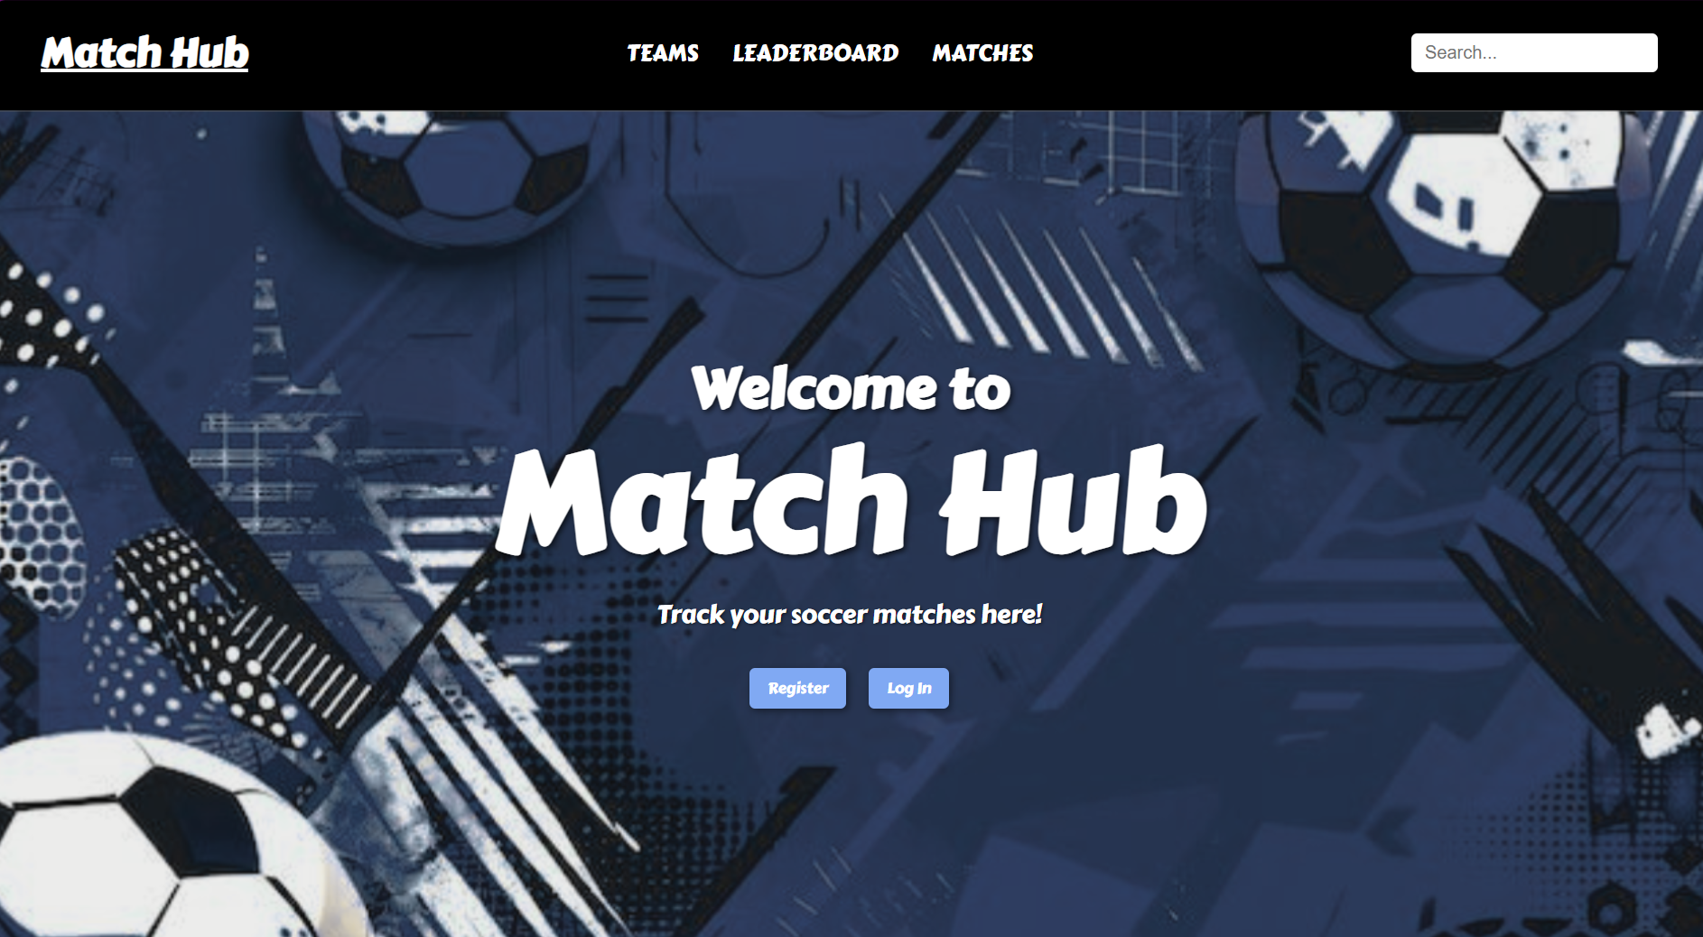
Website Features (working)
Home Page

Slide 6
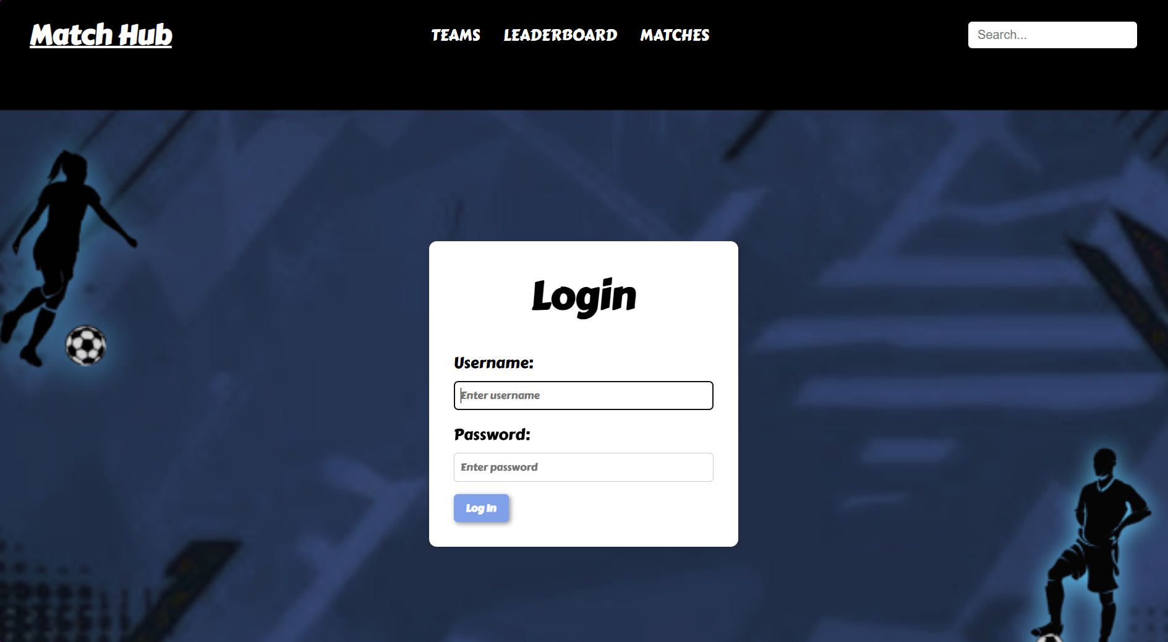
Website Features (working)
Login Page

Slide 7
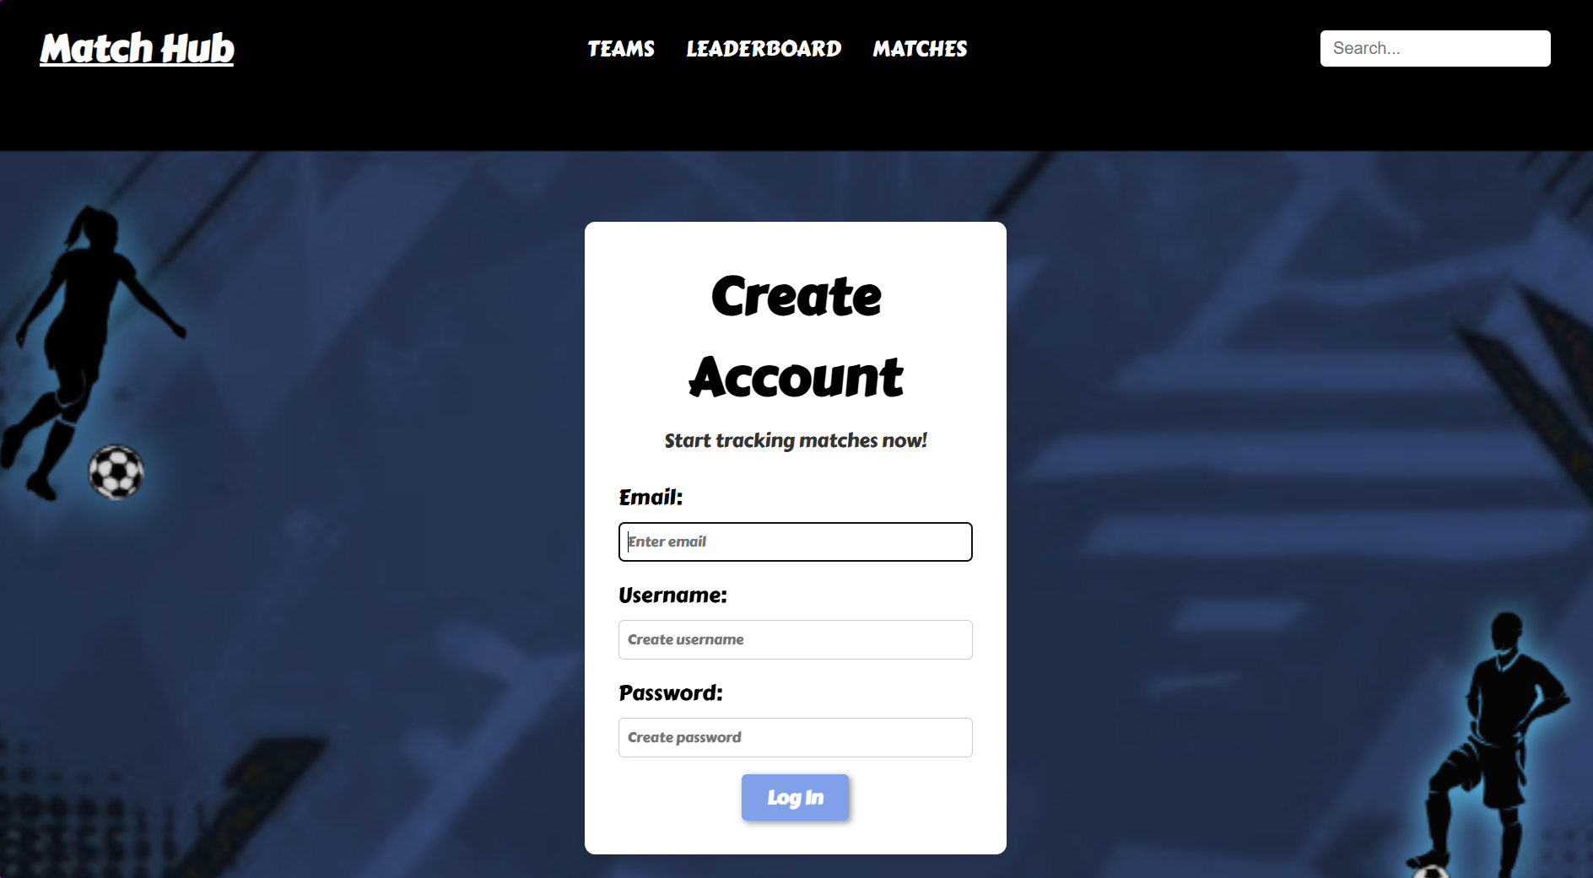
Website Features (working)
Register Page

Slide 8

Website Features (on-going)
Search bar functionality improvement
Enable automatic leaderboard updates
Refactoring of upcoming matches page
Splash page development

Slide 9
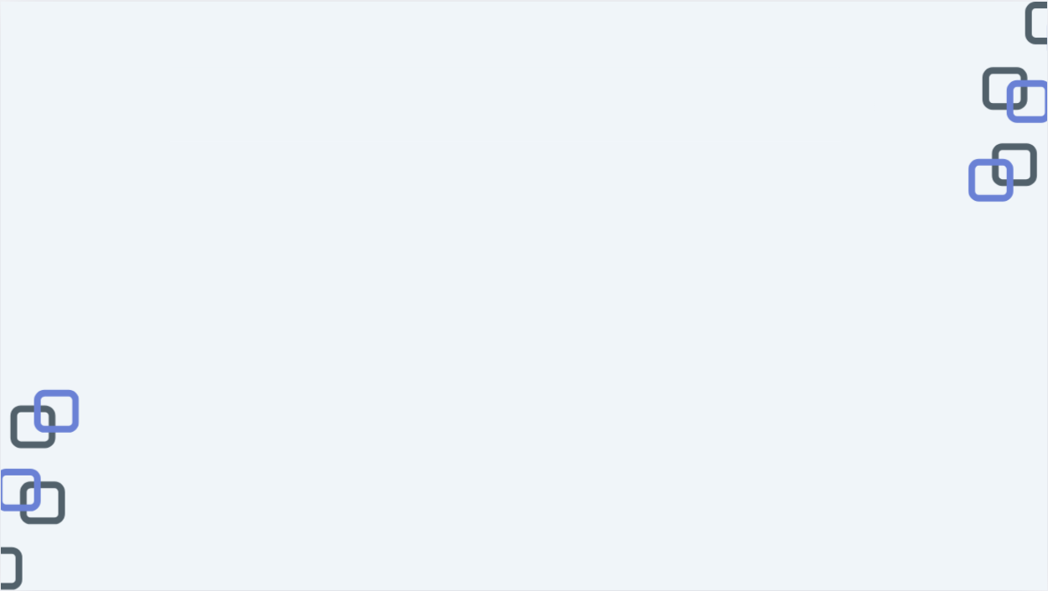
Future Improvements
Account management section
Implement password hashing
Automated security email alerts
  Account changes
  Login sessions
Email and password formatting requirements

Slide 10

THANK YOU!!

